Slide 1
Section 1.2
Quadratic Equations
Copyright © 2012 Pearson Education, Inc. Publishing as Prentice Hall.

Slide 2
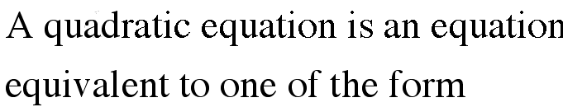

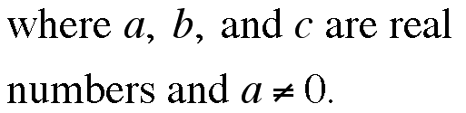
Quadratic Equations
Copyright © 2012 Pearson Education, Inc. Publishing as Prentice Hall.

Slide 3
Copyright © 2012 Pearson Education, Inc. Publishing as Prentice Hall.

Slide 4

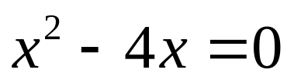
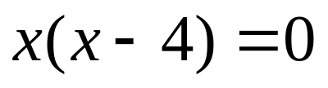


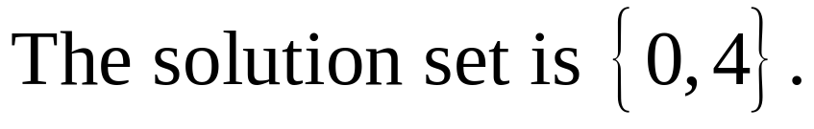
Solve the equation:
Copyright © 2012 Pearson Education, Inc. Publishing as Prentice Hall.

Slide 5
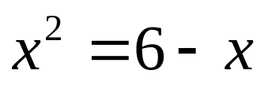
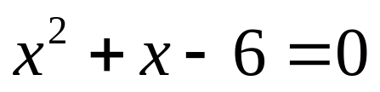
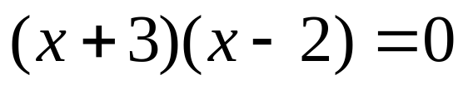

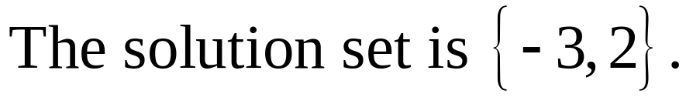
Solve the equation:
Copyright © 2012 Pearson Education, Inc. Publishing as Prentice Hall.

Slide 6


Copyright © 2012 Pearson Education, Inc. Publishing as Prentice Hall.

Slide 7

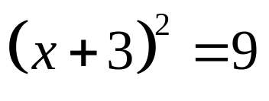
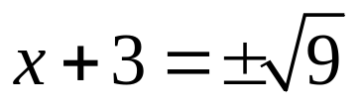
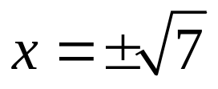

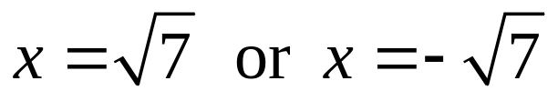


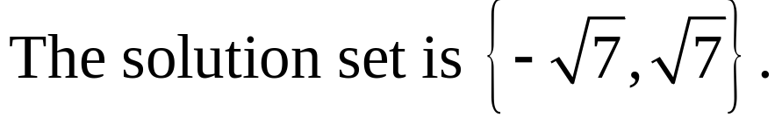
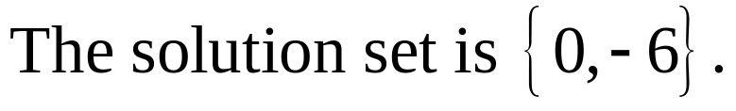
Solve each equation.
(a) (b)
Copyright © 2012 Pearson Education, Inc. Publishing as Prentice Hall.

Slide 8
Copyright © 2012 Pearson Education, Inc. Publishing as Prentice Hall.

Slide 9
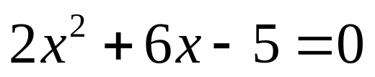
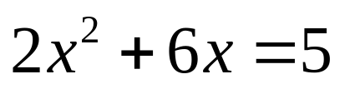
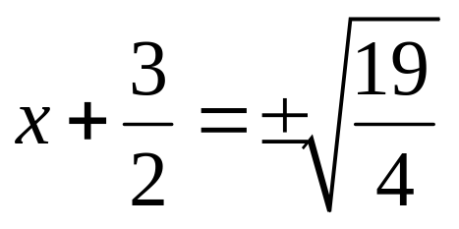
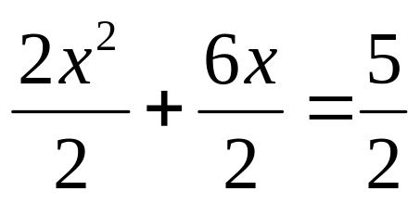
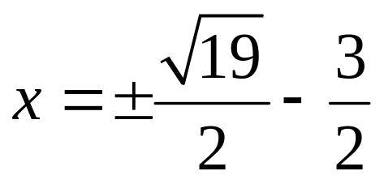
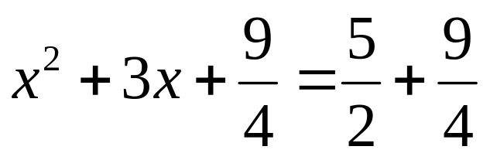
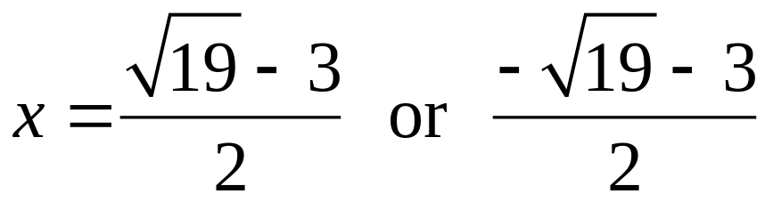
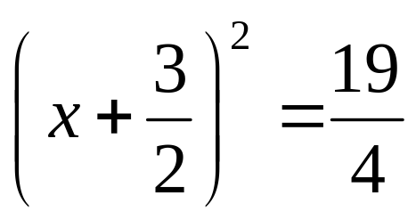
Solve by completing the square:
Copyright © 2012 Pearson Education, Inc. Publishing as Prentice Hall.

Slide 10
Copyright © 2012 Pearson Education, Inc. Publishing as Prentice Hall.

Slide 11
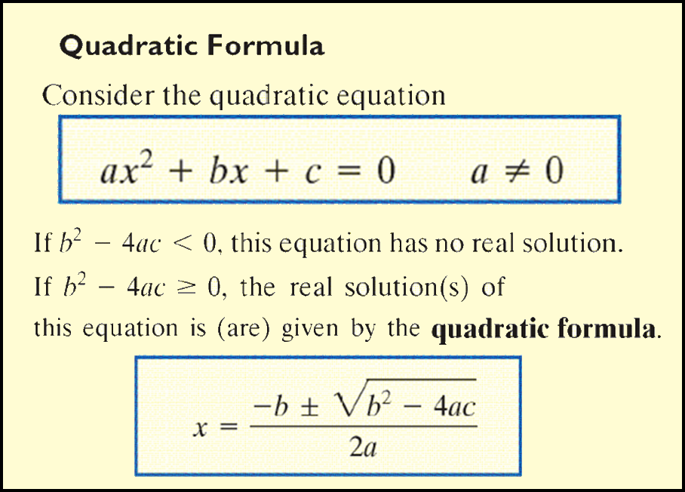
Copyright © 2012 Pearson Education, Inc. Publishing as Prentice Hall.

Slide 12
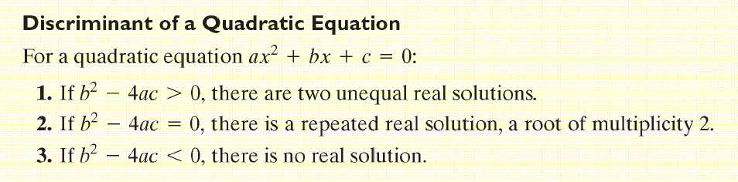
Copyright © 2012 Pearson Education, Inc. Publishing as Prentice Hall.

Slide 13
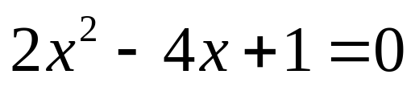
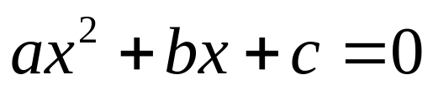
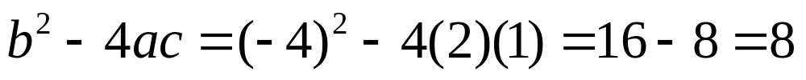
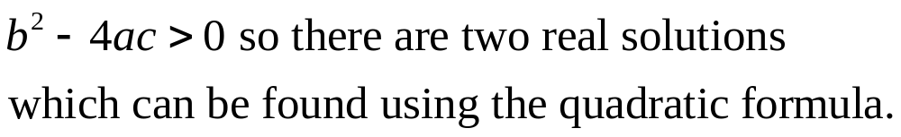
Use the quadratic formula to find the real solutions, if any, of the equation
Copyright © 2012 Pearson Education, Inc. Publishing as Prentice Hall.

Slide 14
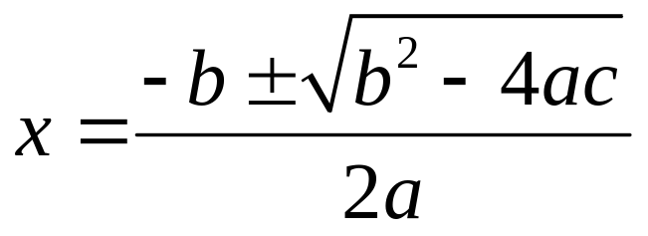
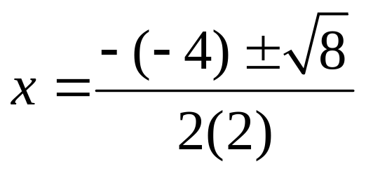
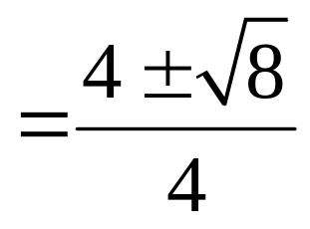
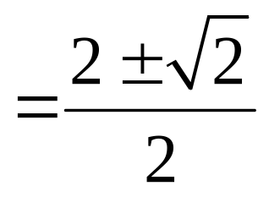
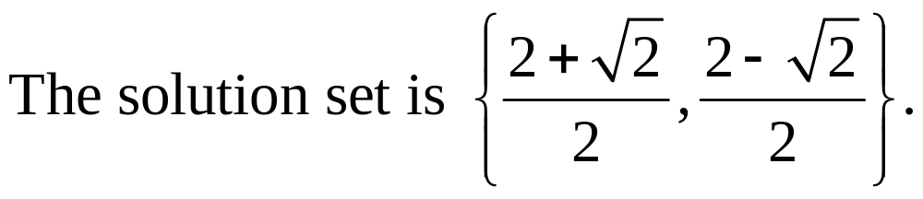
Use the quadratic formula to find the real solutions, if any, of the equation
Copyright © 2012 Pearson Education, Inc. Publishing as Prentice Hall.

Slide 15
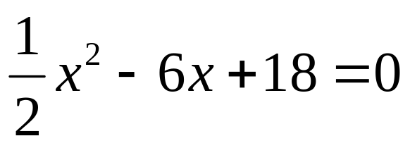
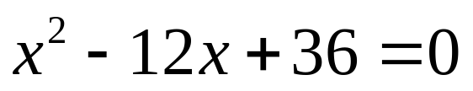
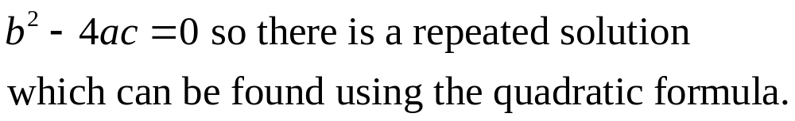
Use the quadratic formula to find the real solutions, if any, of the equation
Copyright © 2012 Pearson Education, Inc. Publishing as Prentice Hall.

Slide 16
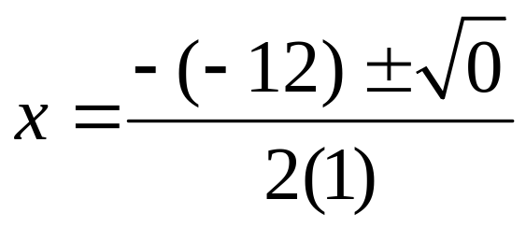
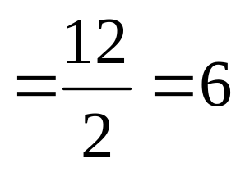
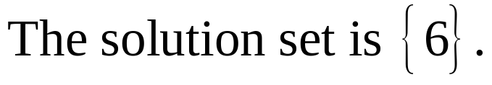
Use the quadratic formula to find the real solutions, if any, of the equation
Copyright © 2012 Pearson Education, Inc. Publishing as Prentice Hall.

Slide 17
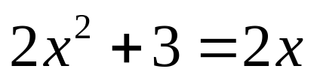
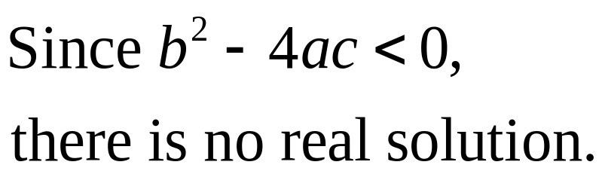
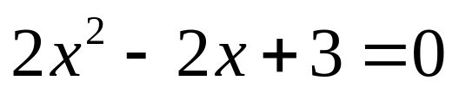
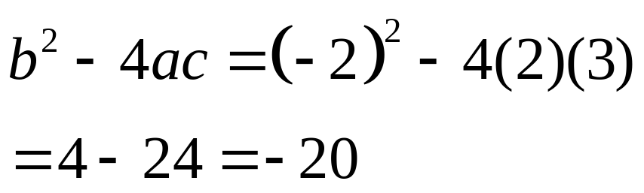
Use the quadratic formula to find the real solutions, if any, of the equation
Copyright © 2012 Pearson Education, Inc. Publishing as Prentice Hall.

Slide 18
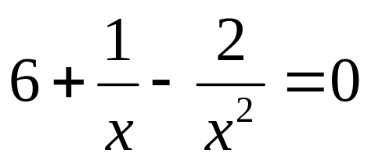
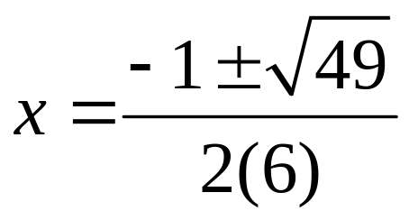
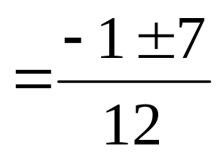
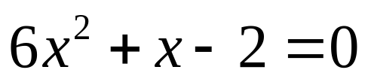
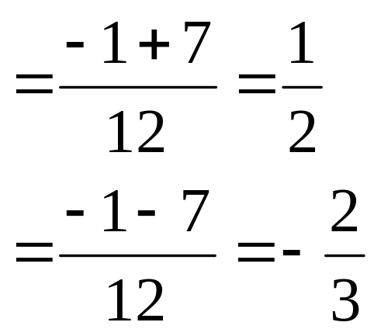
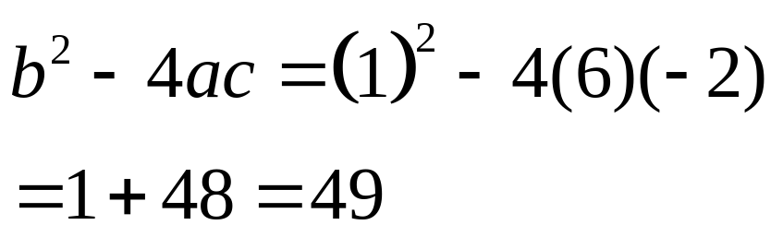


Use the quadratic formula to find the real solutions if any, of the equation
Copyright © 2012 Pearson Education, Inc. Publishing as Prentice Hall.

Slide 19

Copyright © 2012 Pearson Education, Inc. Publishing as Prentice Hall.

Slide 20
Copyright © 2012 Pearson Education, Inc. Publishing as Prentice Hall.

Slide 21




Copyright © 2012 Pearson Education, Inc. Publishing as Prentice Hall.

Slide 22




22 centimeters by 22 centimeters
Copyright © 2012 Pearson Education, Inc. Publishing as Prentice Hall.

